Slide 1
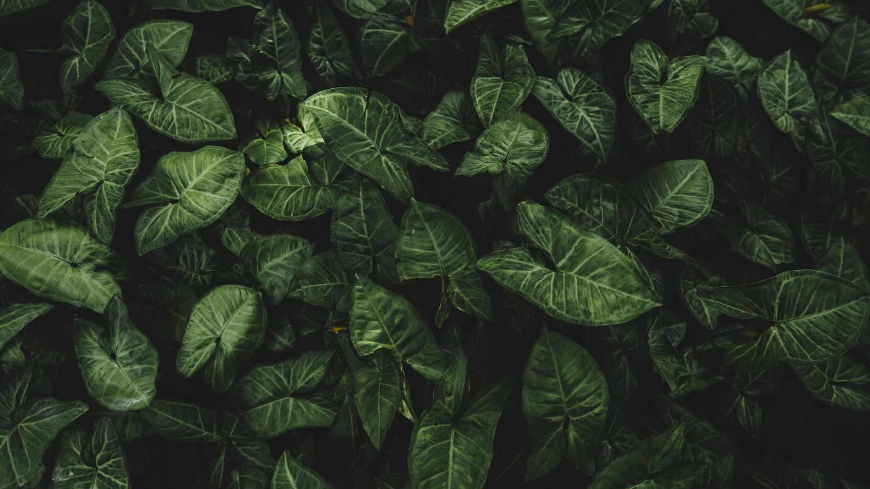
Mid-Project Demonstration: Burnt area detection with satellite imagery
By Jovan Radan [jor75]
Supervisor Natthakan Iam-On [nai7]
Second Marker Faisal Rezwan [far8]
Aberystwyth University
Degree Scheme: GG47 – BSc, Computer Science and Artificial Intelligence (with integrated year in industry)

Slide 2
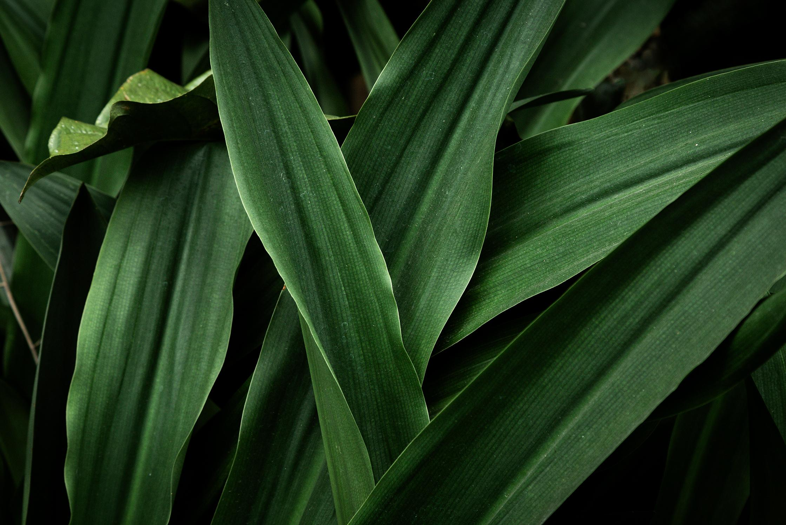
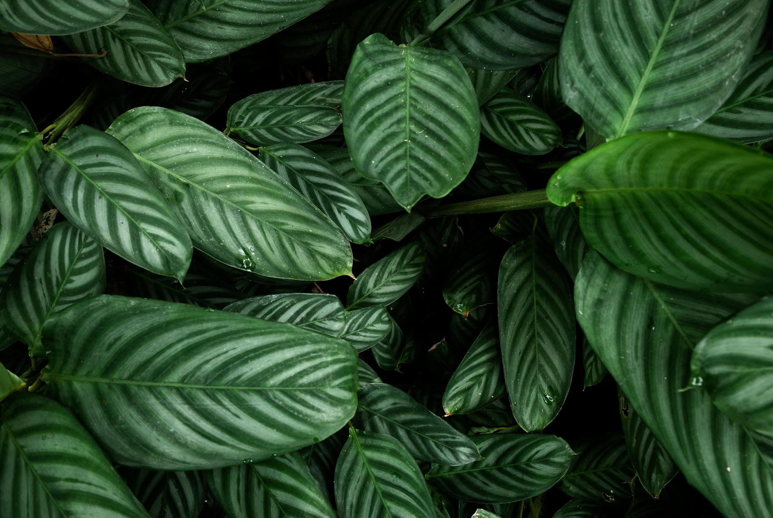
Table of Contents
Problem background
Experimental Designs
Demo – Code
Sentinel 2 Information
Questions about why we need this technology
Data Acquisition and Preprocessing
A guide of what I’ve done so far
Combinations, Bands, Burnt area methods

Slide 3
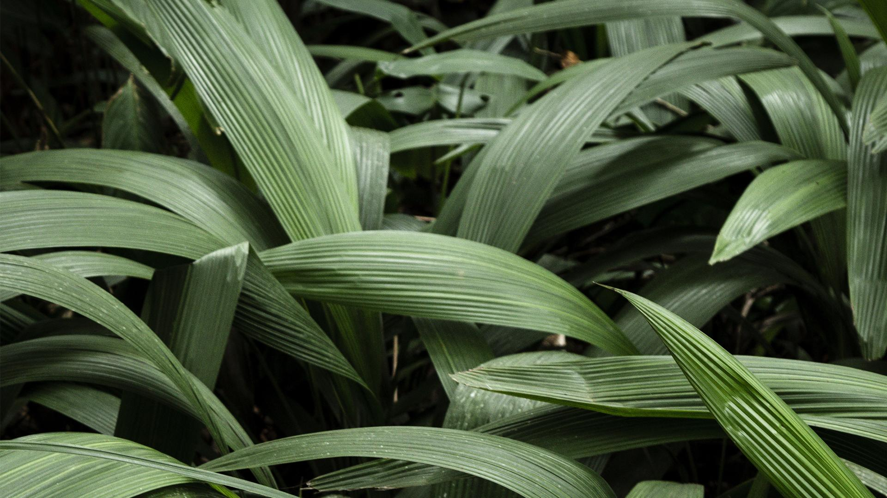
Problem background
Questions about why we need this technology

Slide 4
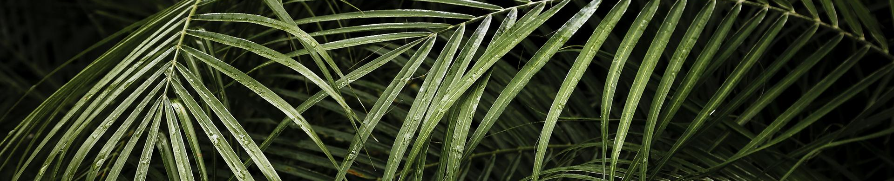
Research Questions
How is satellite imagery being used in different fields, such as environmental monitoring, disaster response, urban planning, and agriculture?
What are the ethical considerations of using satellite imagery, such as privacy concerns and the potential for misuse?
How can ML and AI be used to analyse satellite imagery for specific purposes?

Slide 5
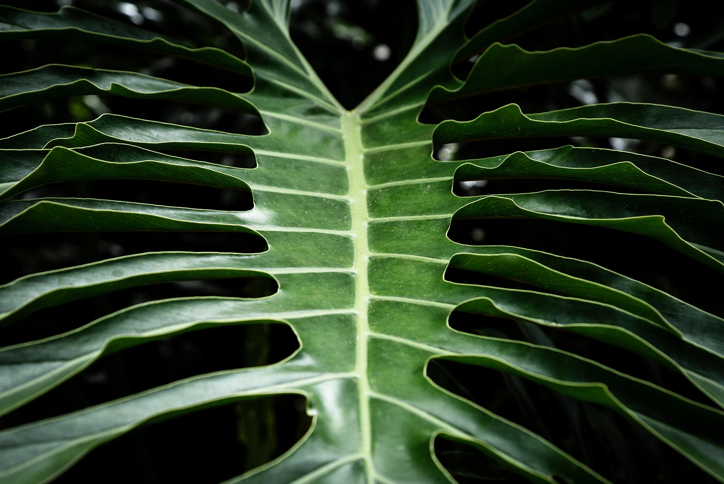
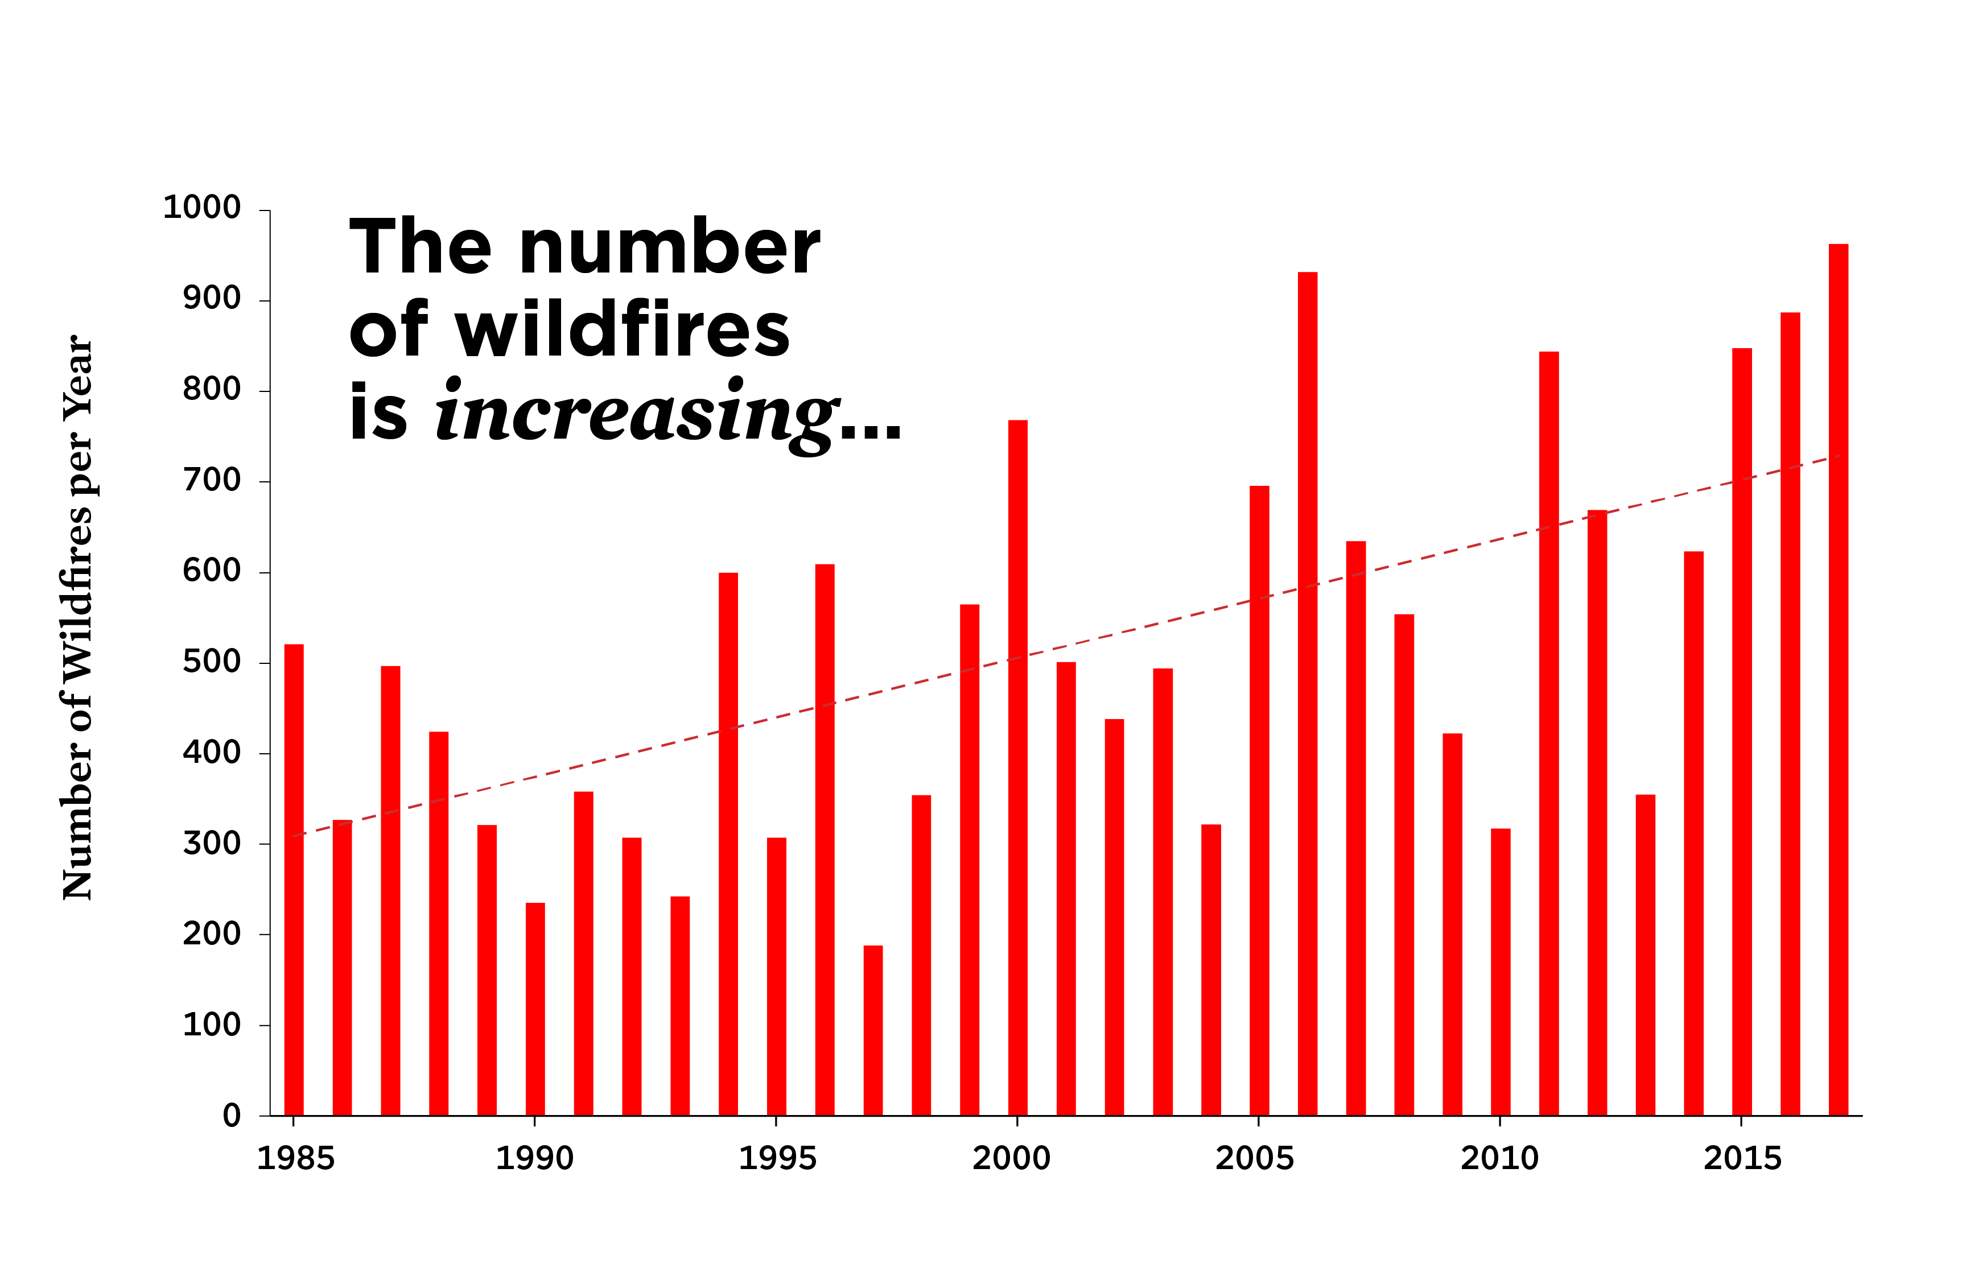
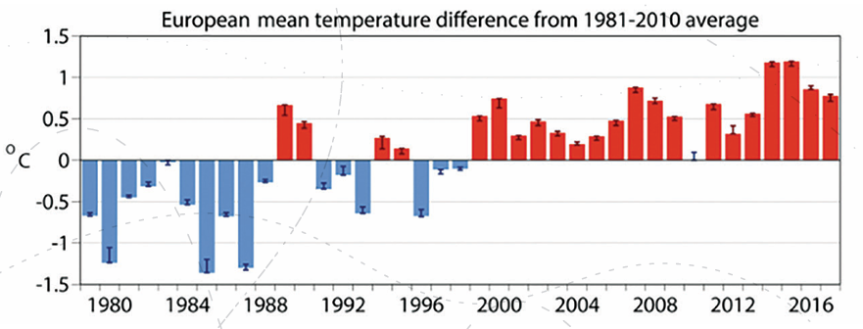
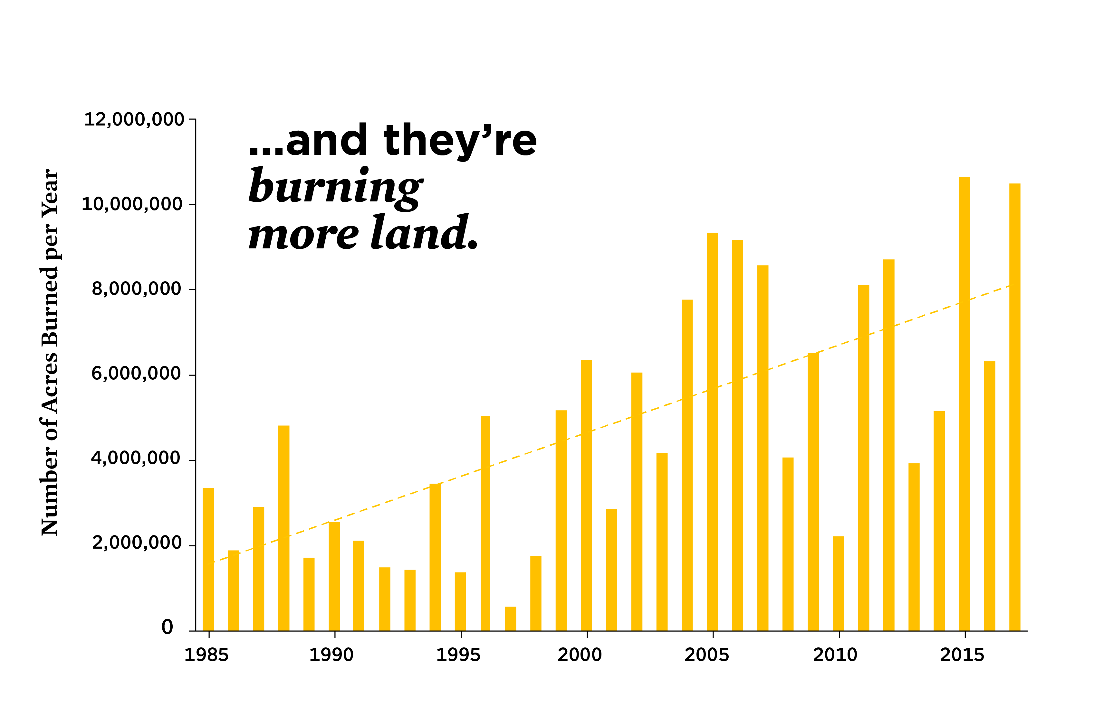
Wildfires are getting worse
AMERICA
As we can see in both charts, the trend is rising; one of the reasons for this is that wildfires are much more prevalent than it used to be.
Brochure_Copernicus_2019 updated_0.pdf
Credit to: https://www.ucsusa.org/resources/infographic-wildfires-and-climate-change for Bar Charts

Slide 6
Objective
To explore deep learning for burnt area detection in satellite imagery.
Feature Extraction: Convolutional Neural Networks (CNNs) are made to automatically extract features from images.
Complexities and Context: Satellite imagery is complex as there are factors that can make the results differ, such as weather or land cover.
Multispectral Data: We need to have various band combinations so we can have multiple models to show if an area has some burnt area, as changes in reflectance cross the spectrum between burnt and healthy vegetation.
Improved Accuracy
To compare different deep learning models and find the best parameter setting
CNN’s = Architecture to specifically learn spatial features from images = ideal for our objective.
U-Net = It translates pixel-wise classifications (specific to semantic segmentation) = ideal for identifying flood zones, segmenting different types of vegetation, or even creating detailed urban maps.
Vision Transformers = A new approach that utilises mechanisms to analyse relationships between different parts of an image. It captures long-range dependencies that are potentially useful for identifying large-scale patterns like deforestation or changes in weather patterns.

Slide 7
Experimental Designs
Data Acquisition and Preprocessing

Slide 8
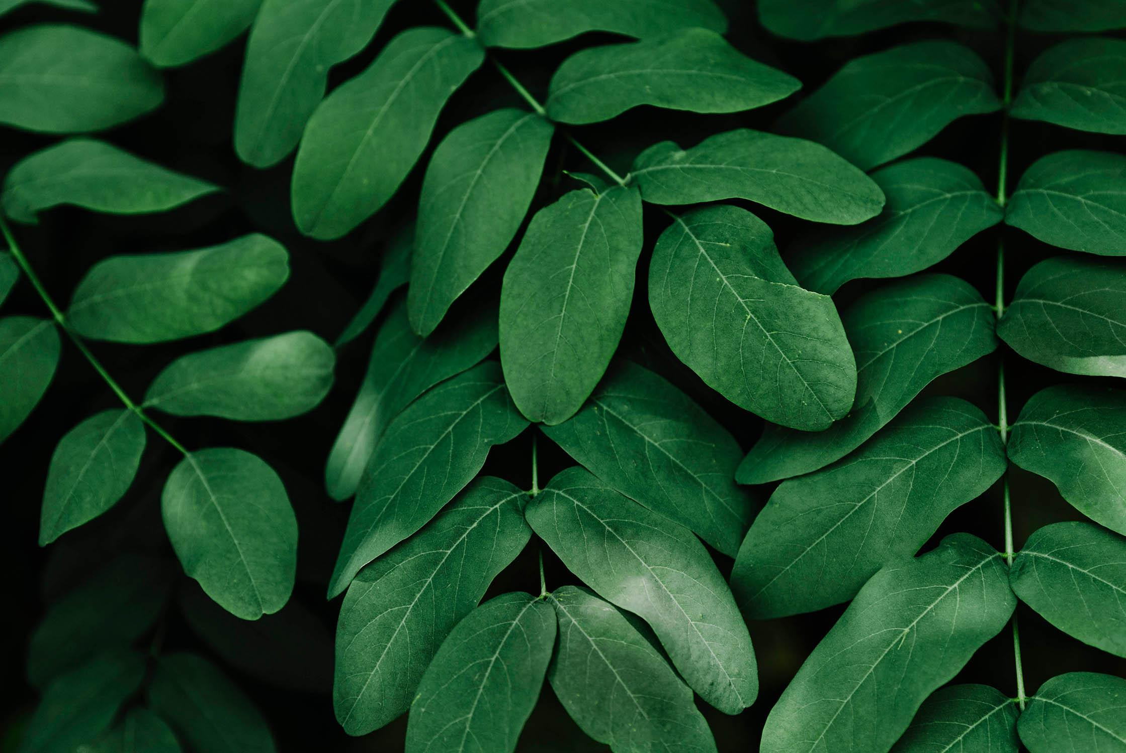
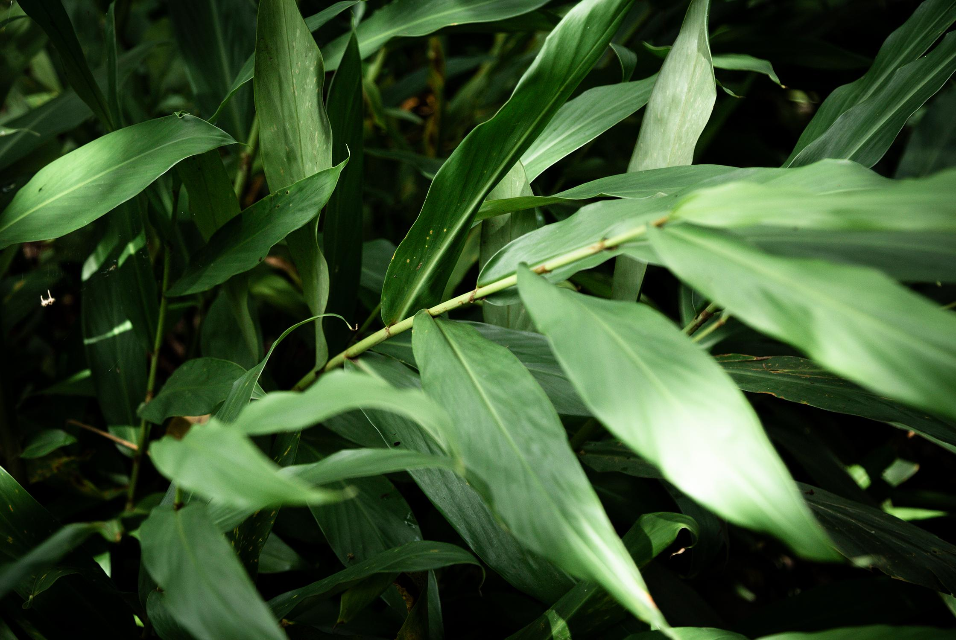
Experimental Designs
Satellite Data Selection
Ground Truth Labelling
Data Preprocessing
Choosing sensors with spectral bands sensitive to fire signatures: Sentinel-2. It is also important to consider multi-temporal data to capture pre- and post-fire conditions. We will discuss the bands and combinations later.
The goal is to automatically label burned and unburnt areas on a subset of images.
Data/Spectral Normalisation - Works within specific ranges depending on the band combinations.
Data Augmentation, e.g. Random flipping, cropping, rotation, colour interjection
Handling of missing data - remove the data or fill them with average.
Deep Learning Architecture
Training and Evaluation
Evaluation Metric
Can use Convolutional Neural Networks (CNNs) for image recognition as it is the industrial norm to analyse images with deep learning. Possibly incorporate recurrent layers (LSTMs) if using time series data (multi-temporal imagery)
Cross-Validation: To divide labelled data into training and validation sets. The training set is used to train the model, and the validation set is used to monitor performance and prevent overfitting.
Loss function allows us to gauge how effectively our algorithm captures patterns/marks items in the data. - Cross-entropy loss for pixel-wise classification of burned and unburned areas.

Slide 9
Demo - Code
A guide of what I’ve done so far

Slide 10
Sentinel-2 Information
Combinations, Bands, Burnt area methods

Slide 11
Sentinel-2 Information – Bands & Combinations
Sentinel-2 carries a Multi-Spectral Imager (MSI), which has 13 sensors to deliver bands ranging from 10-60 meters in pixel size.
Used to better understand the feature in imagery. We extract specific info from an image. For example, there are band combinations that highlight geologic, agriculture, or vegetation features in images.
The best band combinations to use for burnt area detection would be:
“Short-wave infrared”
“Agriculture”
“Geology”
“Vegetation Index”
“Moisture Index”
Referring toSentinel 2 Bands and Combinations - GIS Geography

Slide 12
Different methods to detect Burnt area’s
Spectral Indices
Multi-Temporal Satellite Imagery
Deep Learning Models
Machine Learning-Based Approaches: Random Forest
One way is to use Normalised Burn Ratio (NBR)
‘Near Infrared’ (NIR) + ‘shortwave Infrared’
It ranges from -1 to 1 to show a clear indication of what is what.
However, U-Net has shown the highest accuracy in detecting burnt areas in recent forest events in South Korea Credit: Machine Learning-Based Forest Burned Area Detection with Various Input Variables: A Case Study of South Korea (mdpi.com)
Used in remote sensing to highlight pixels showing the relative amounts (High or low) of land-cover type. Which is applied to various spectral bands of an image per pixel.
In practical terms, It's the difference between two selected bands normalised by their sums.
An example is the Normalised Difference Vegetation Index (NDVI)
Is when collections of satellite images are captured over time, allowing easier observations to see changes to the environment.
Which is what we talked about in our objective.

Slide 13
Reasons to use Sentinel-2 Imagery
The images are more accurate post-event delineation of wildfire.
Additional data can be used in conjunction with imagery by a variety of organisations to assess, monitor, and respond to the areas and communities affected by such wildfires.
The info obtained can be used to carry out risk assessments of the affected and surrounding areas.
Sentinel-2 data collected over time can be used to monitor environmental recovery, especially in relation to agriculture and forestry.
Which will benefit GIS users as well as non-GIS users.

Slide 14
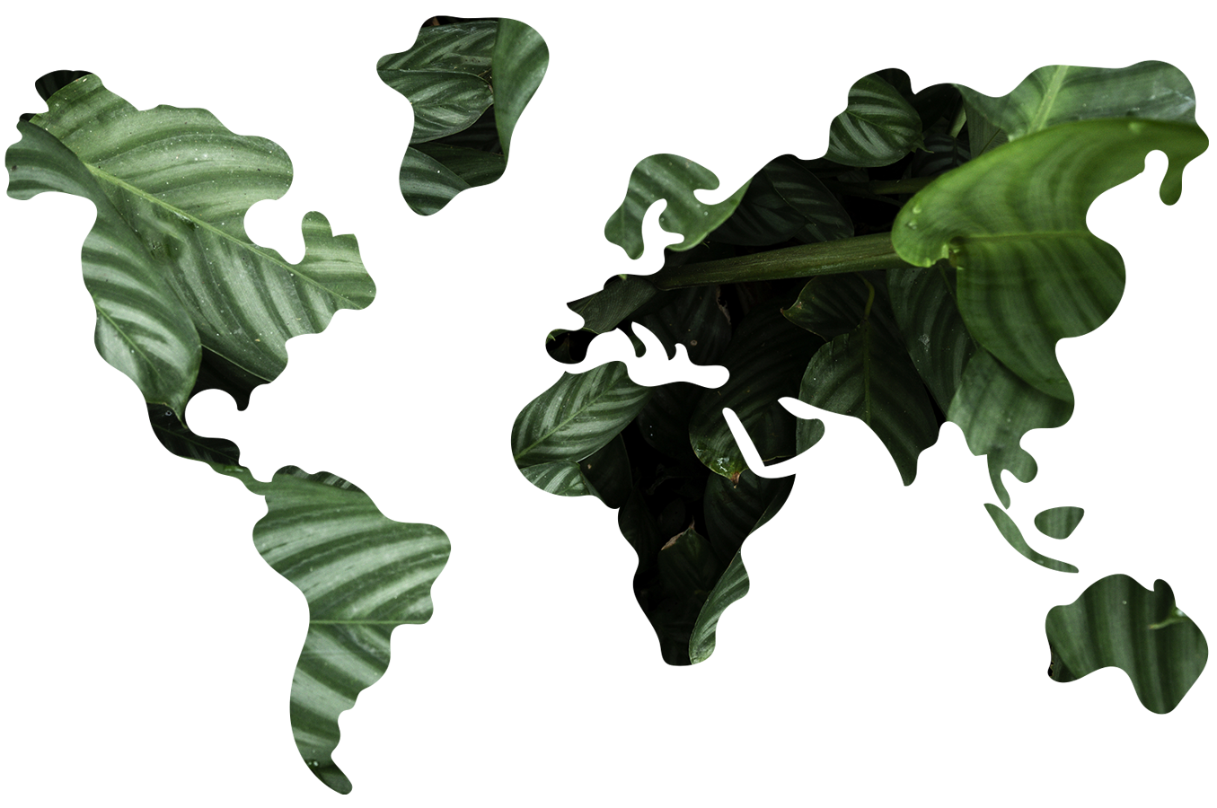
Our focus with datsets
Europe
America
Southeast Asia
Possible Dataset areas
Africa

Slide 15
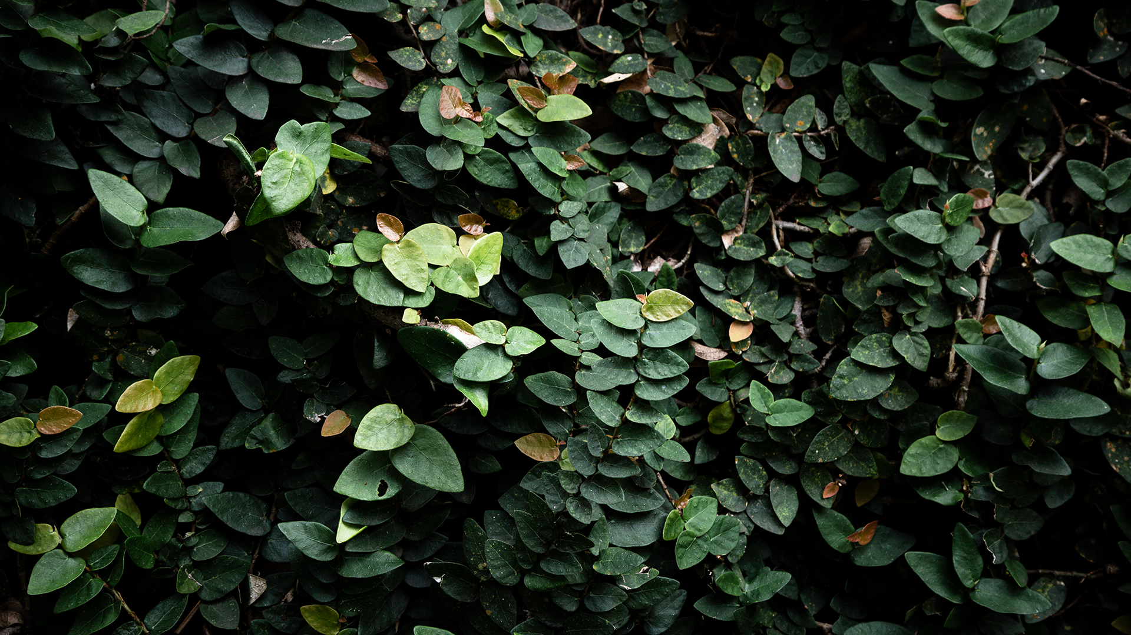
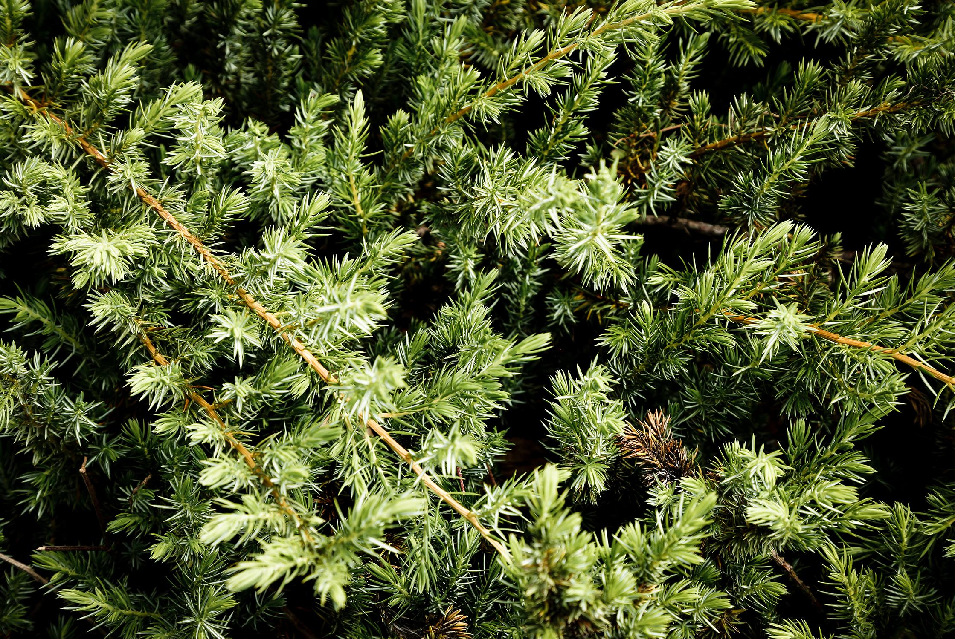
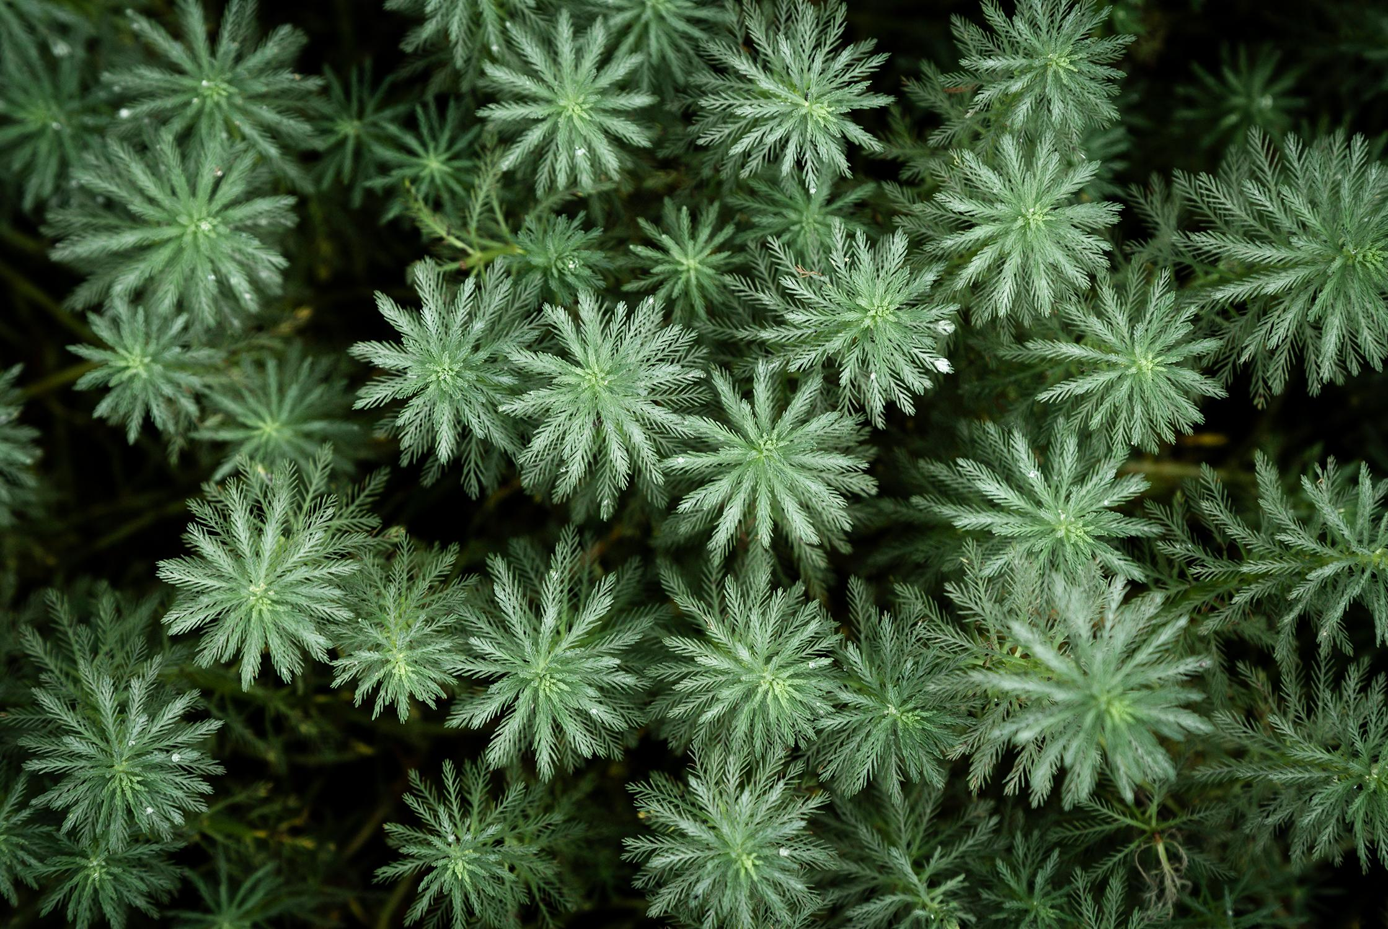
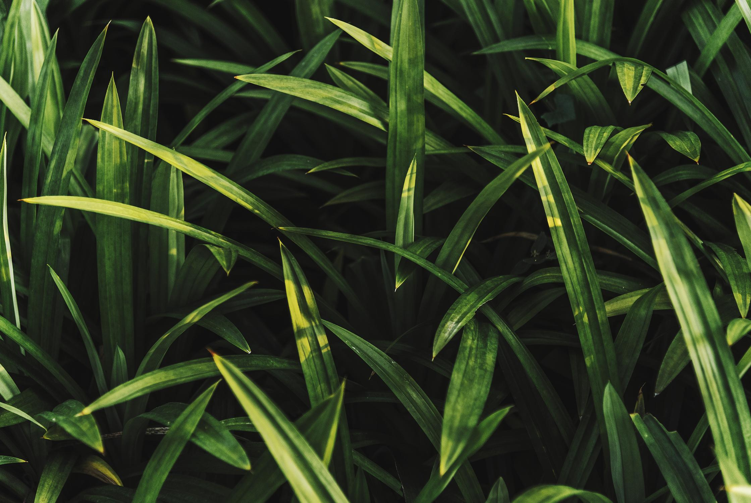
Datasets
Dataset 01
Dataset 02
Dataset 03
Dataset 04
Southeast Asia
https://forobs.jrc.ec.europa.eu/sentinel/sentinel2_composite
America
https://www.kaggle.com/datasets/avkashchauhan/california-wildfire-dataset-from-2000-2021
Europe
https://data.jrc.ec.europa.eu/dataset/0bd1dfab-e311-4046-8911-c54a8750df79
Africa
https://forobs.jrc.ec.europa.eu/sentinel/sentinel2_composite

Slide 16
Questions?

Slide 17
Thanks
Jor75@aber.ac.uk
+44 1234567890
Please keep this slide for attribution

